Slide 1

Project on National Data Portals in Samoa and Fiji Workshop 2 Experience Sharing and SDMX/.Stat Suite Tools 27-31 January 2025 Suva, Fiji
FMR Workbench: Categories, Constraints, Annotate

Slide 2


Learning objectives
At the end of this session, you will be able to:
Explain the purpose of the SDMX standard, outline its history and governance structure.
Identify the main parts of the SDMX specification and access official material on the Web.
Support the business case for SDMX and recognise its main use cases and key enablers.

Slide 3
Outline
Relevance of standards
What is SDMX?
SDMX timeline
Versions of SDMX
SDMX governance
SDMX technical standards
Main SDMX artefacts
Content-oriented guidelines
Global DSDs
SDMX business proposition
SDMX use cases
Different modes of exchange
Implementation approaches
SDMX software
Who are the enablers?
SDMX official website

Slide 4
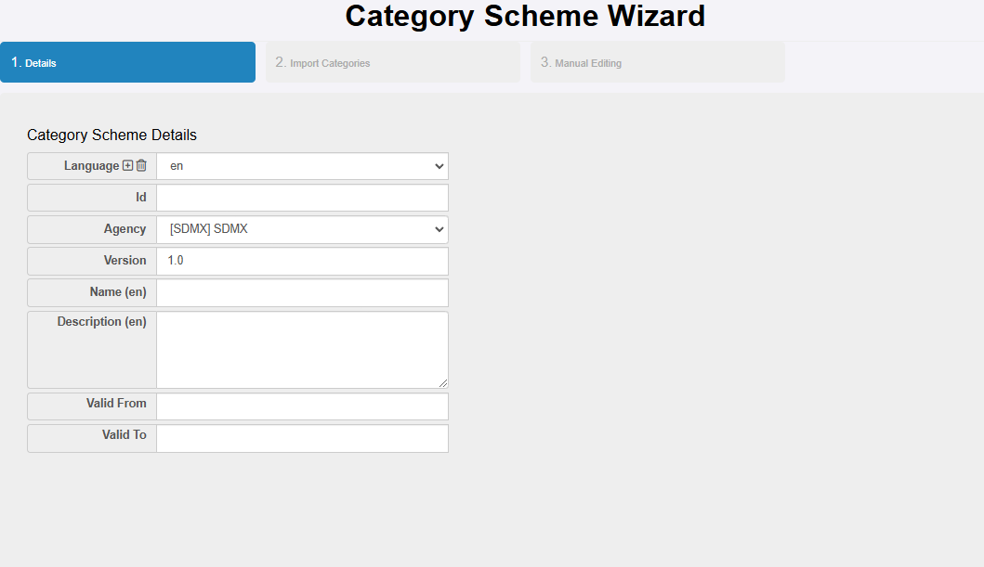
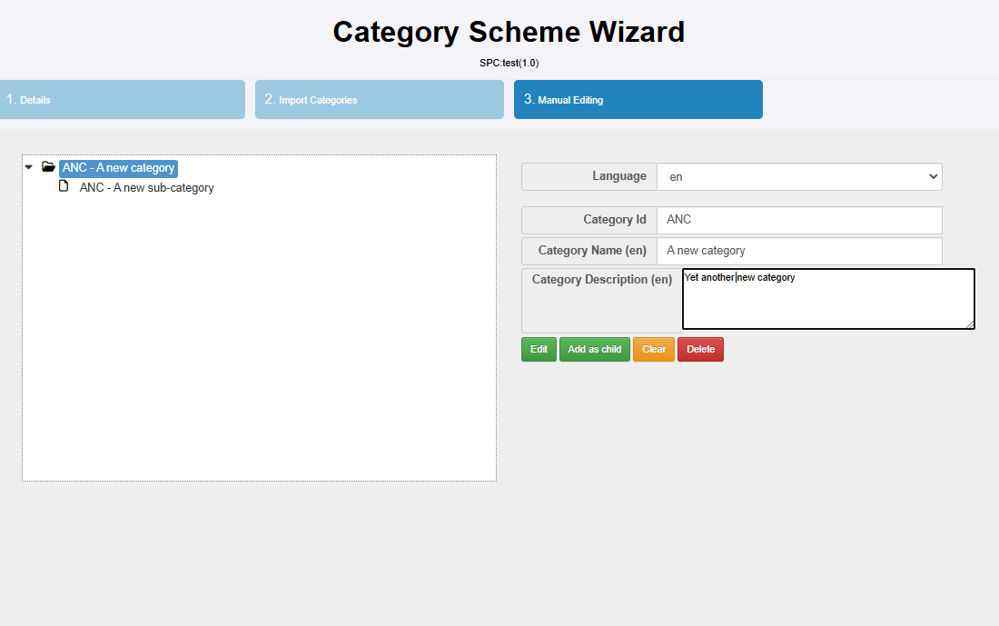
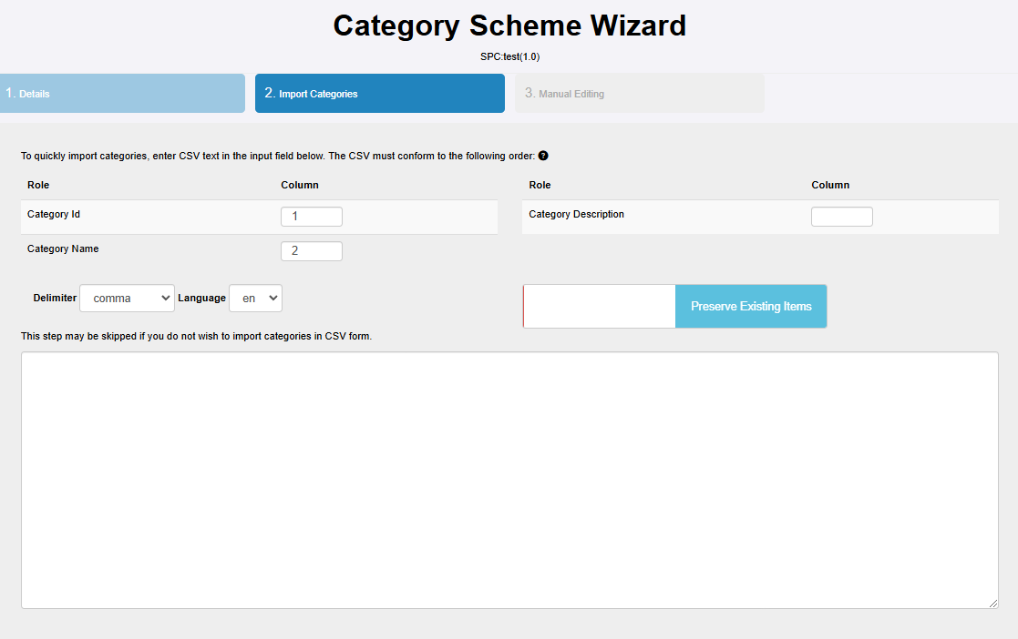
Category Schemes: Wizard
Category schemes organise
DSD and DFS in categories (possibly hierarchical)

Slide 5
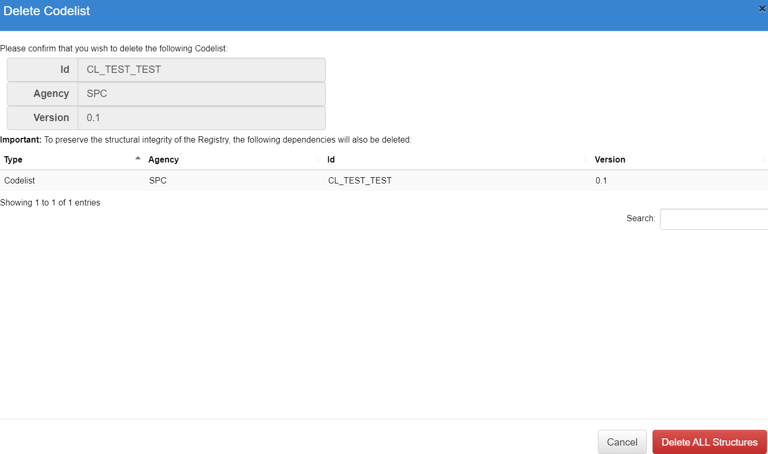
Category Schems: Delete

Slide 6
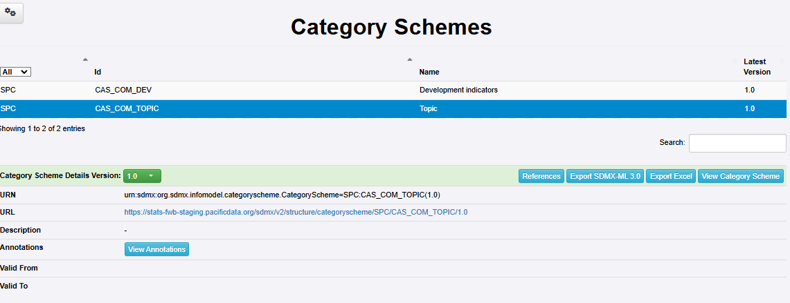
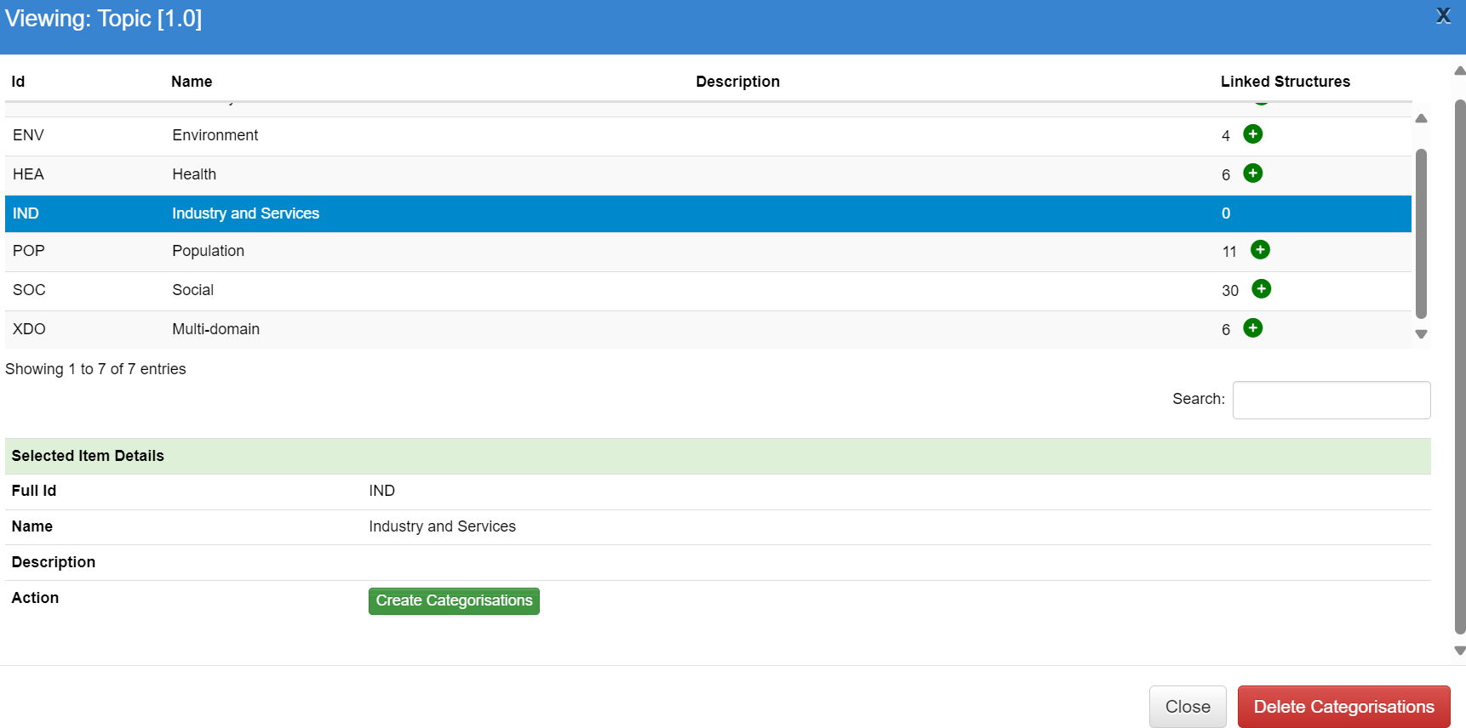


Categorizations: DFs into Categories
The functionality to categories Dataflows is a bit hidden.
1. View a Category Scheme details

Slide 7
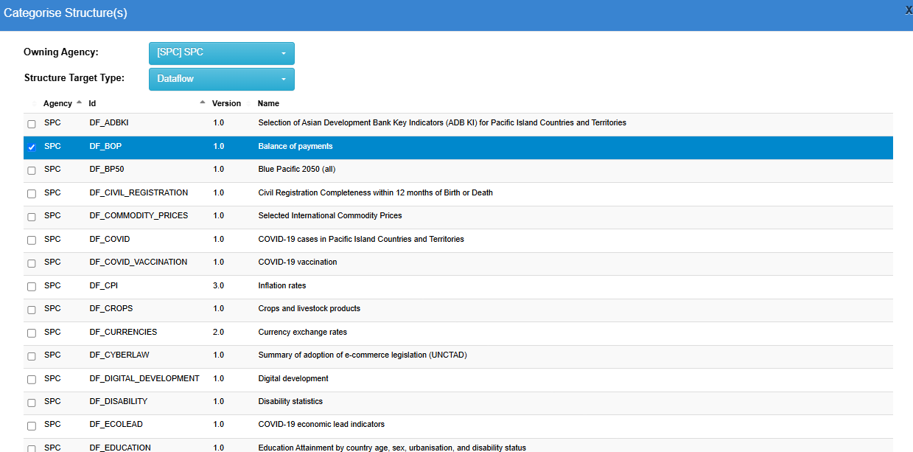
Categorizations: DFs into Categories
The functionality to categories Dataflows is a bit hidden.
View a Category Scheme details
Create Categorisations
Select which structure(s) to file under that category

Slide 8
Categorizations: DFs into Categories
The functionality to categories Dataflows is a bit hidden.
View a Category Scheme details
Create Categorisations
Select which structure(s) to file under that category
By default, FWB creates categorisations files with a weird name: you might want to manually edit it
Download structure
Change name and name of file
Reupload with DLM

Slide 9
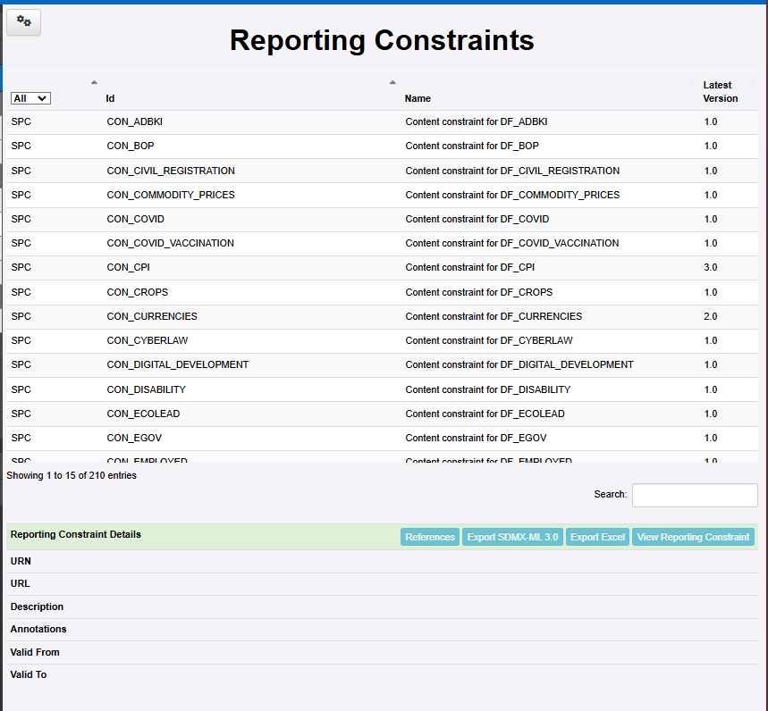
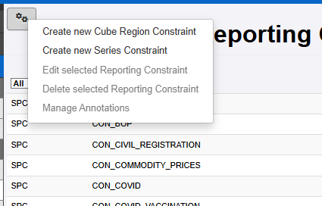
Constraints
Also the functionality for defining constraints is a bit hidden:
You find it in Reporting Constraints

Slide 10
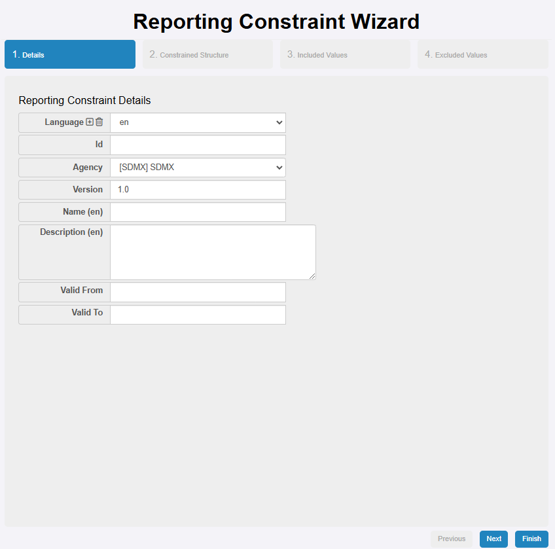
Constraints
Details (multilingual)

Slide 11
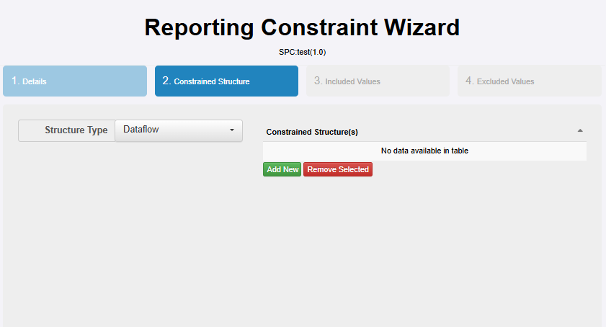
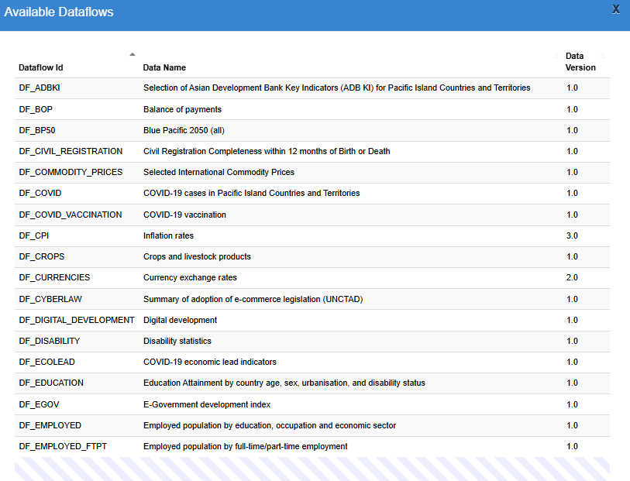
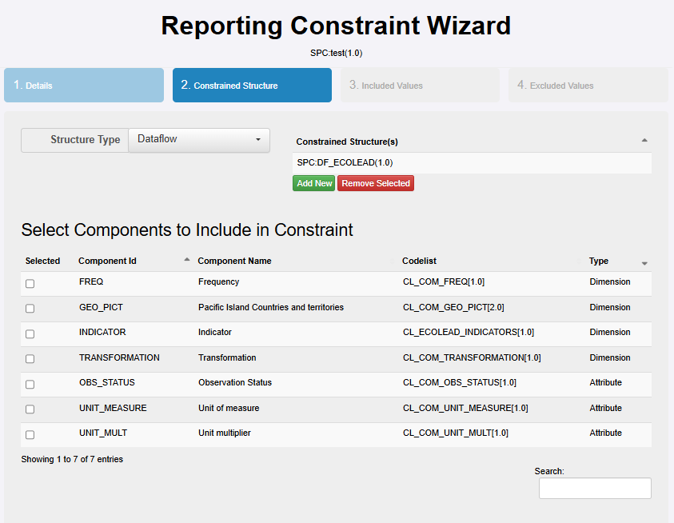
Constraints
Details (multilingual)
Select what to constraint (Which dataflow? Which component?)

Slide 12
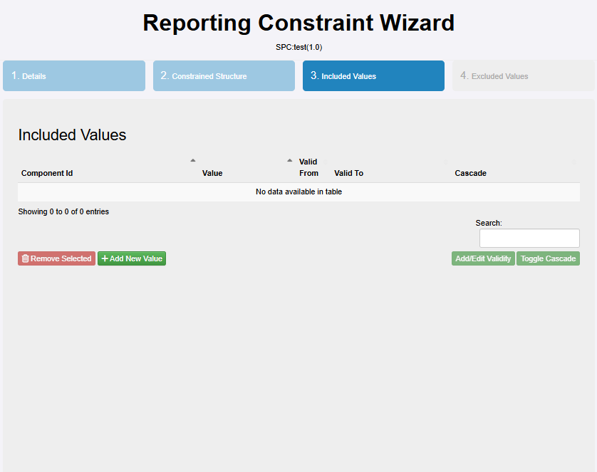
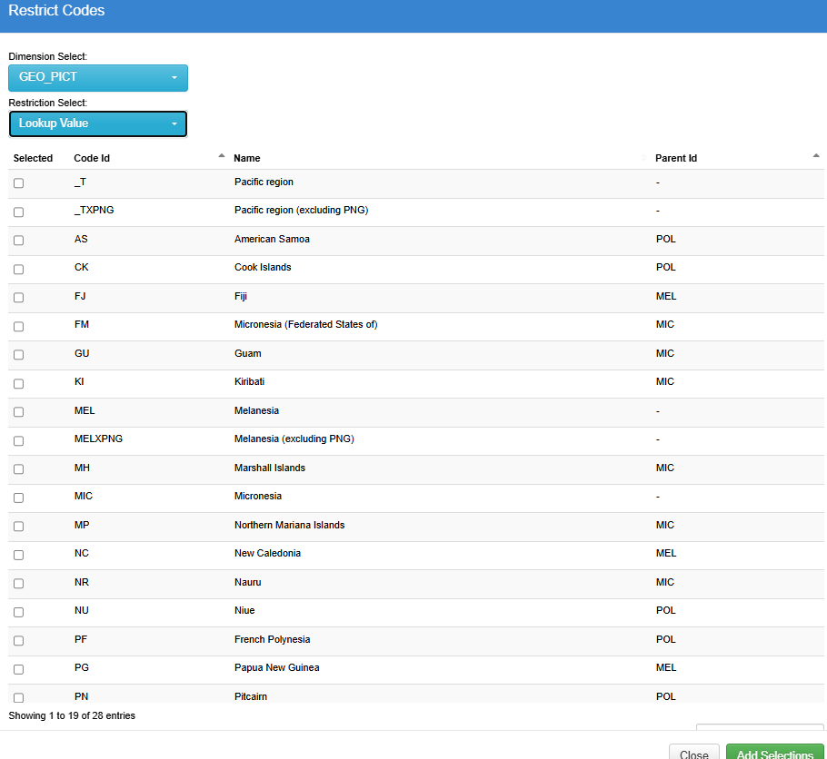
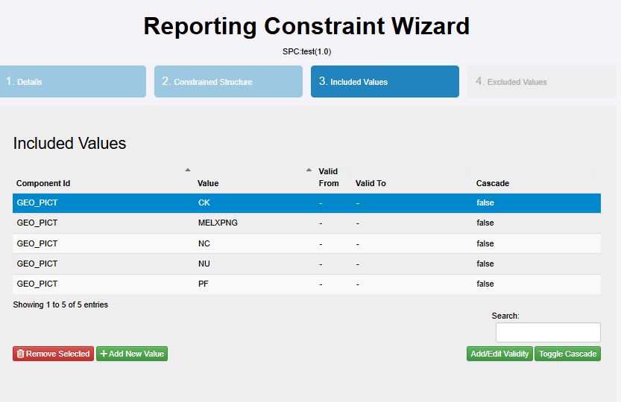
Constraints
Details (multilingual)
Select what to constraint
Include values (optionally from codelist)

Slide 13
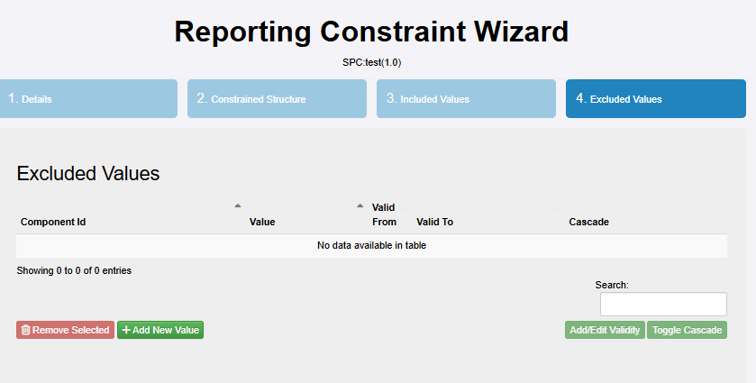
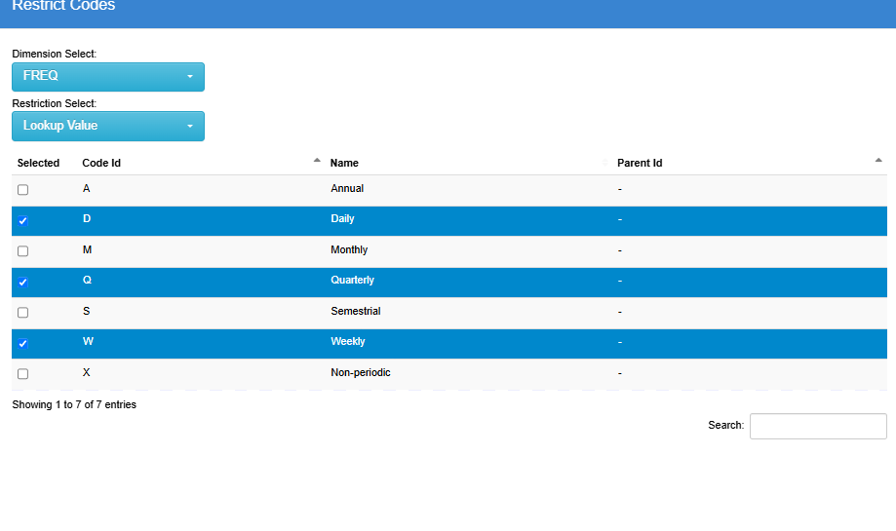
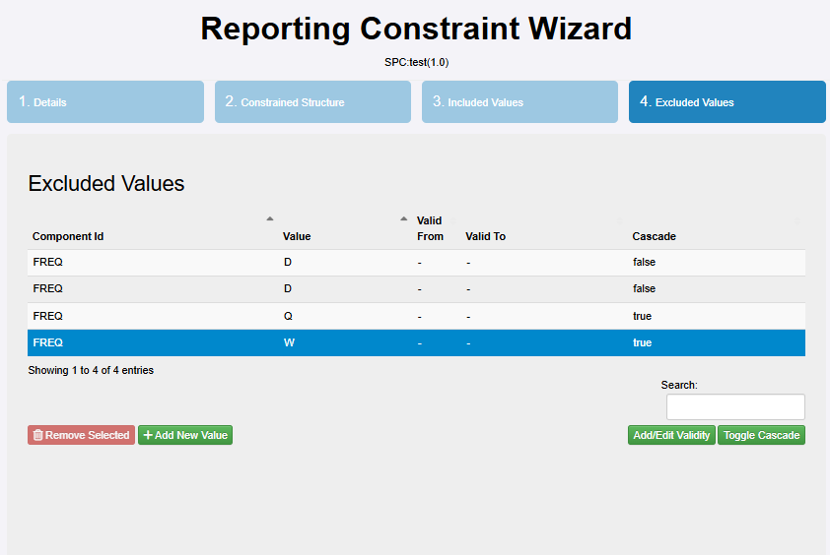
Constraints
Details (multilingual)
Select what to constraint
Include values
Exclude values (optionally from codelist)

Slide 14
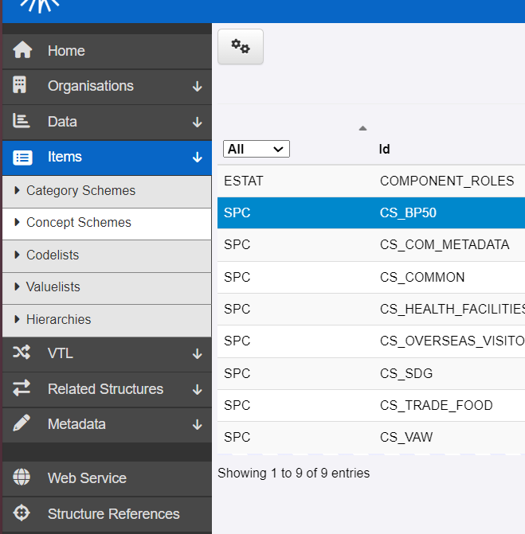
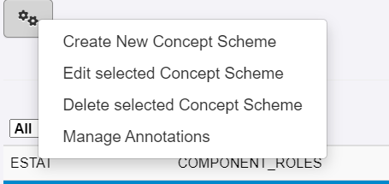
Annotations
Wizard for annotating structures is the same for every type of object
We’ll see it for Concepts

Slide 15
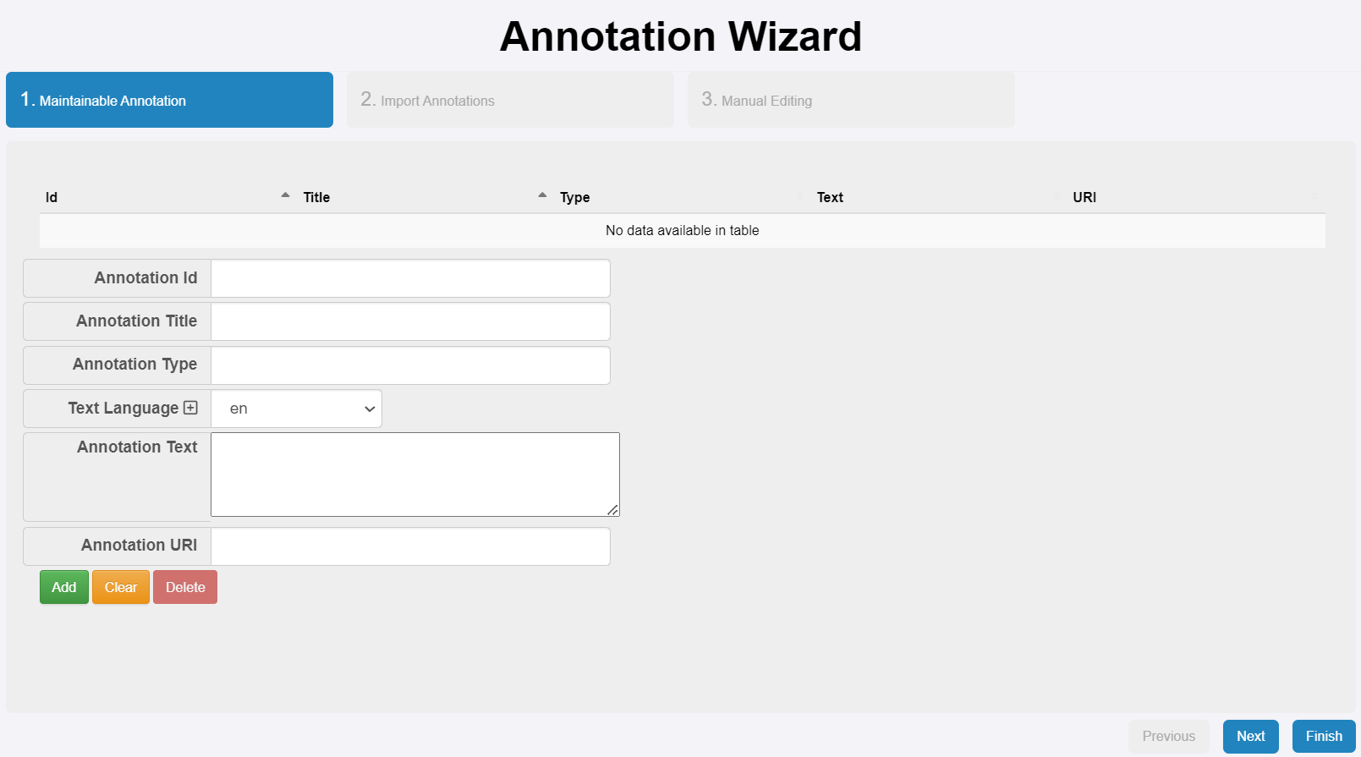
Annotations

Slide 16
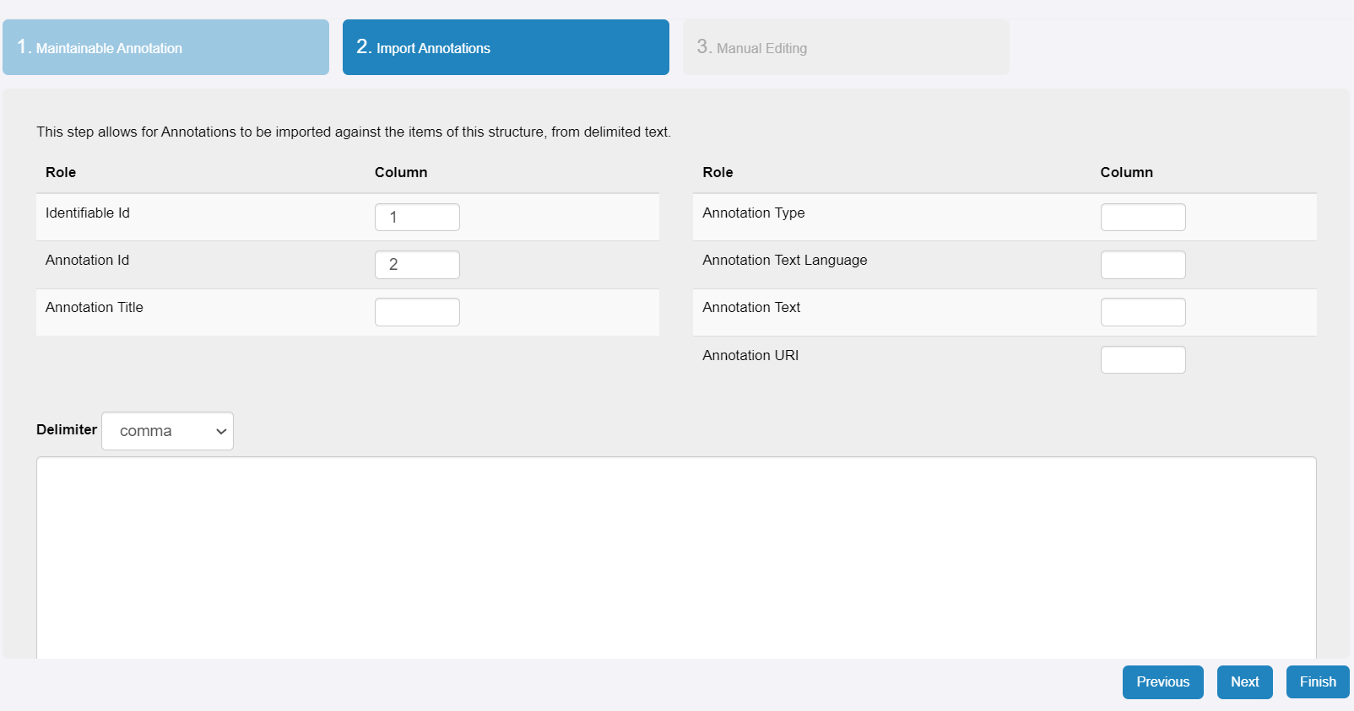
Annotations

Slide 17
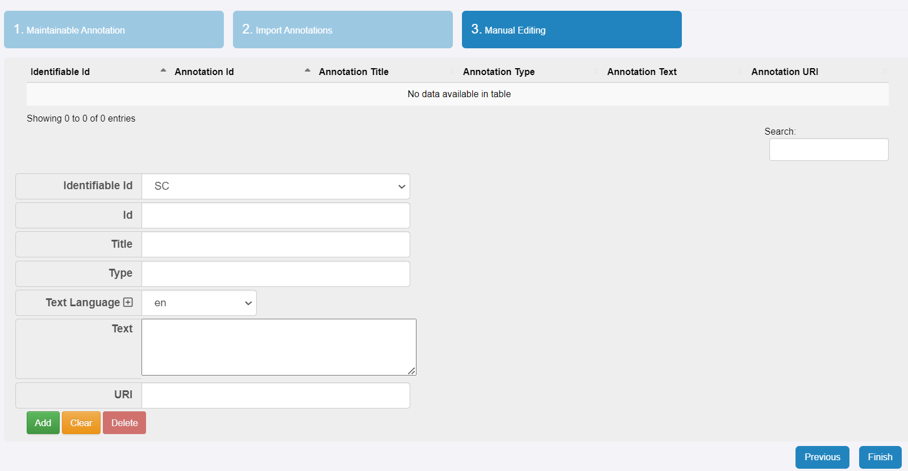
Annotations

Slide 18
Annotations
https://sdmx.org/wp-content/uploads/Guidelines-on-the-use-of-SDMX-Annotations.pdf
This is definitive guide for annotations, we are going to see only a bunch

Slide 19
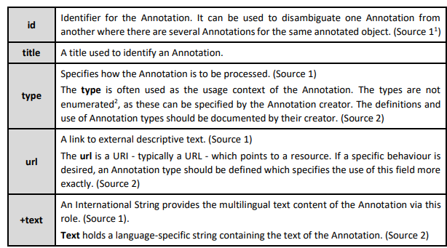
Annotations

Slide 20
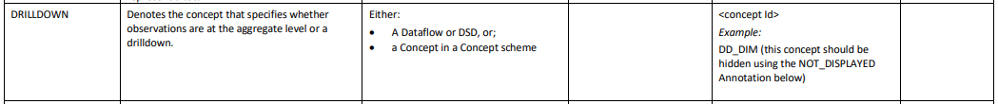
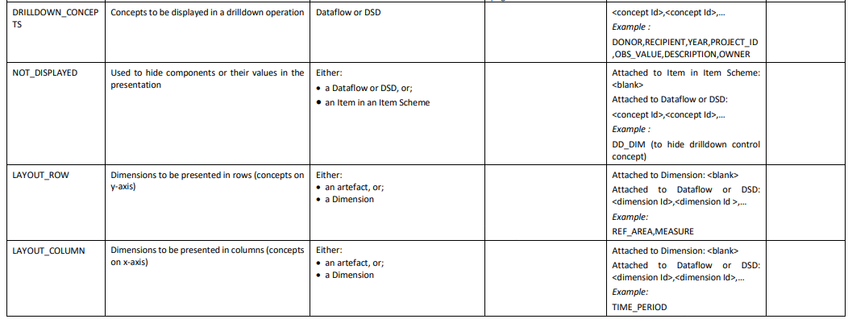
Dataflows: Annotations

Slide 21
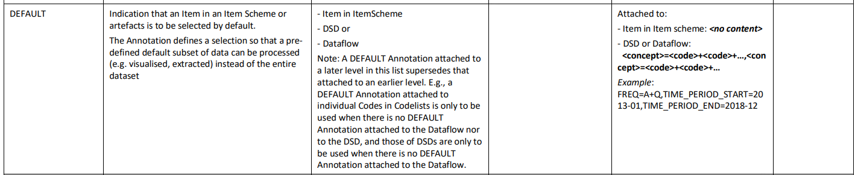
Dataflows: Annotations
Very useful: define how to structure data in DE presentation

Slide 22
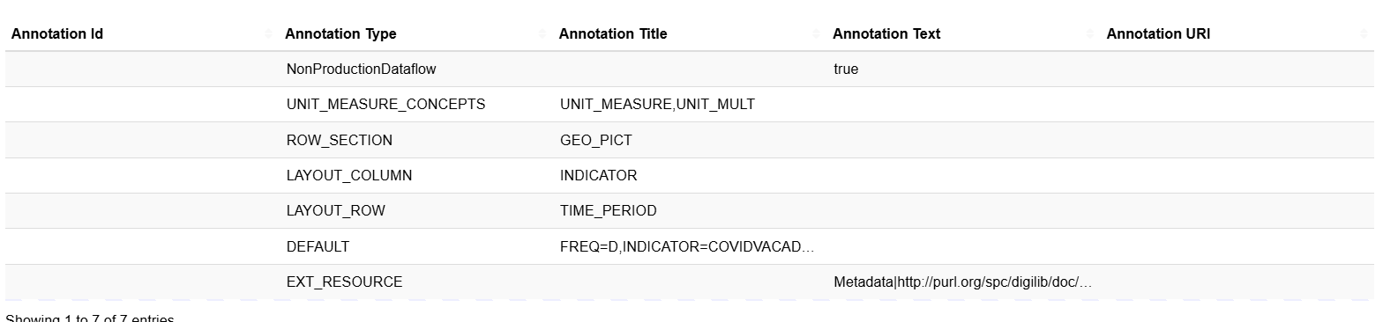
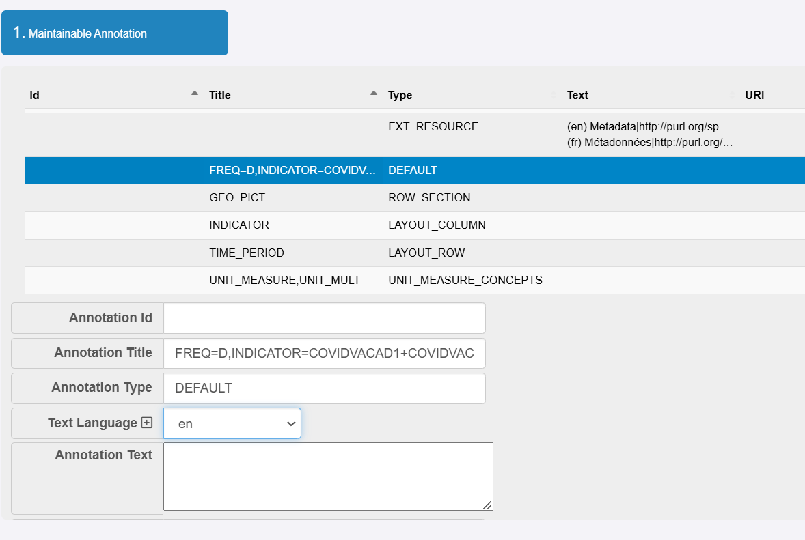
Dataflows: Annotations

Slide 23
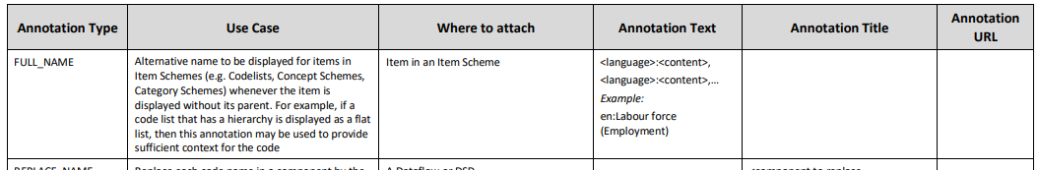
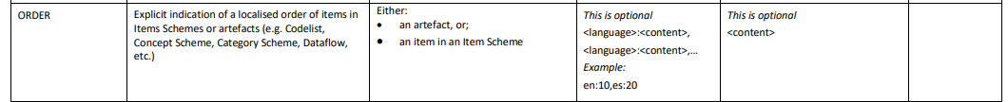
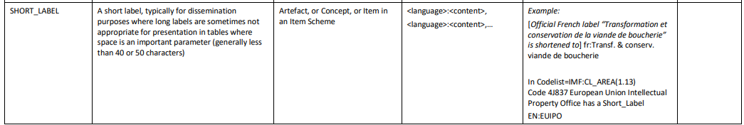
Concept: Annotations

Slide 24
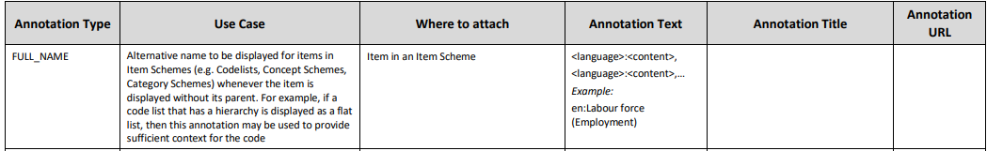
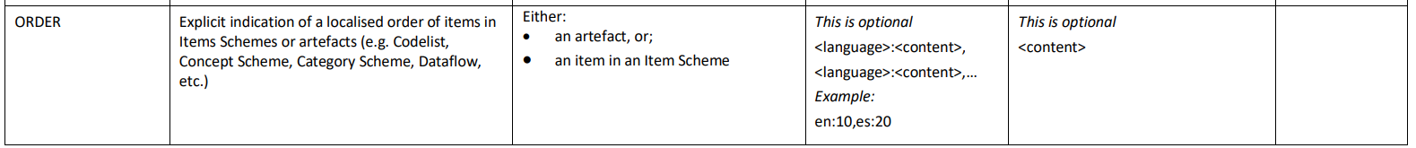
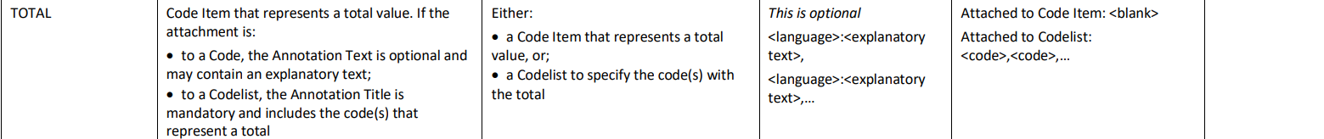
Codelist: Annotations

Slide 25
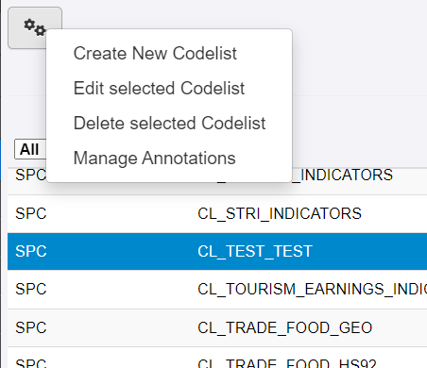
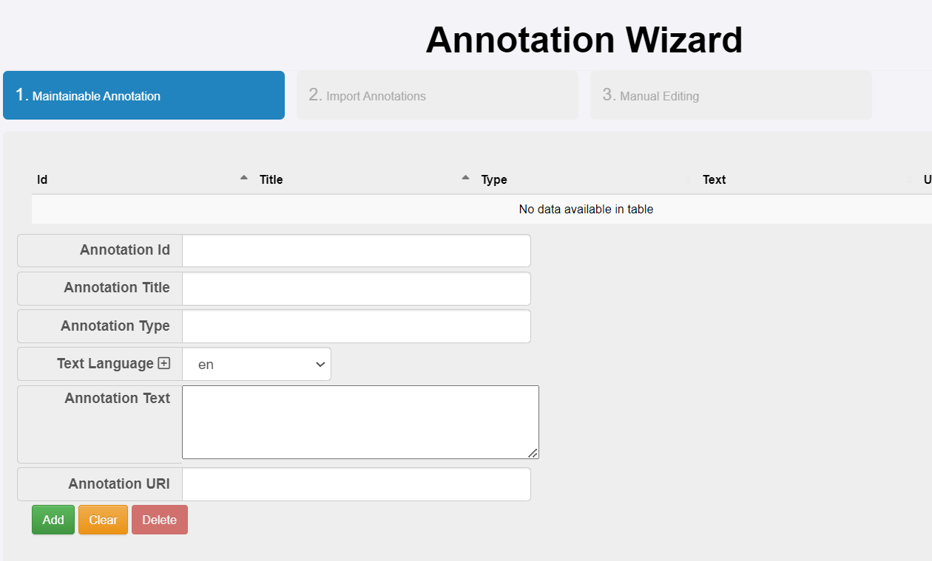
Category Schemes: Annotations

Slide 26
Exercise
Consider Fiji and Samoa published population data (for example: Fiji, Samoa). Using the DSD and DFs we created:
Complete the SDMX modelling by creating categorisations, constraints, and annotations
Validate each other artefacts, or edit them otherwise.

Slide 27
Discussion and Q&A

